Slide 1

PIZZA STORE SALES ANALYSIS

Slide 2
INTRODUCTION
In this project, we dive into the world of pizza sales by analyzing data from a pizza store. With the power of SQL, we aim to answer various advanced business questions. Our dataset comprises four tables: pizzas, pizza types, orders, and order details. Through this analysis, we seek insights into customer preferences, popular pizza types, sales trends, and more, helping the pizza store optimize its operations and boost profitability.

Slide 3
DATASET
Orders Table: Contains unique order identifiers, along with the date and time of each order.
Order Details Table: Includes details of each order, such as the specific pizza ordered (referenced by pizza_id) and the quantity.
Pizza Table: Provides information on each pizza, including its unique identifier, type, size, and price.
Pizza Types Table: Stores details about pizza types, including their unique identifiers, names, categories, and ingredients.

Slide 4
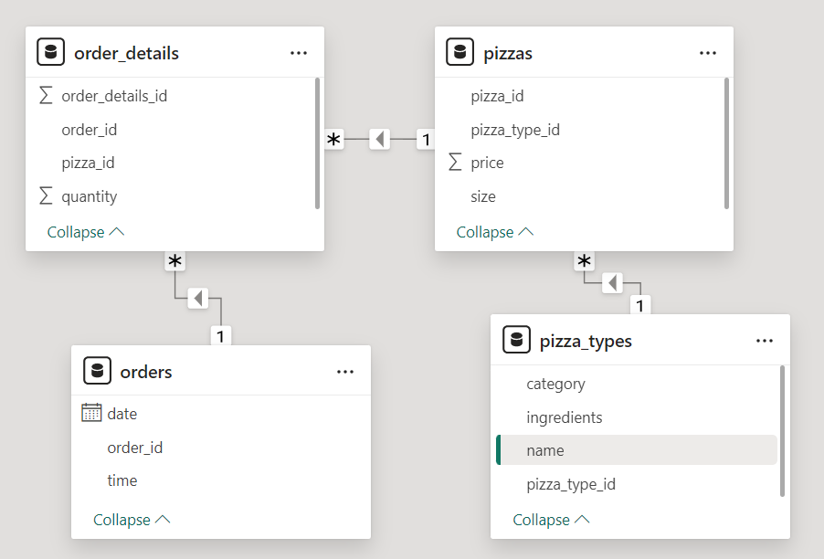
Entity Relationship Diagram

Slide 5
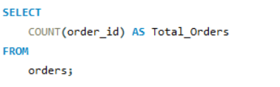

QUESTION 1
Retrieve the total no. of orders placed.
RESULT
QUERY

Slide 6
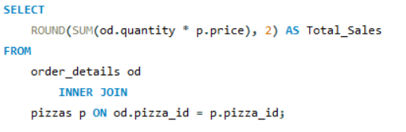

QUESTION 2
Calculate total revenue generated from pizza sales.
RESULT
QUERY

Slide 7
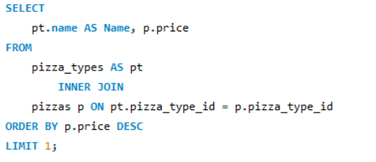

QUESTION 3
Identify the highest-priced pizza.
RESULT
QUERY

Slide 8
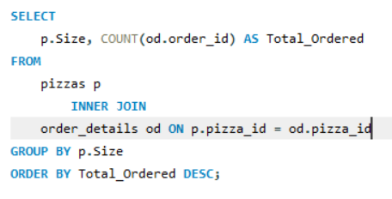
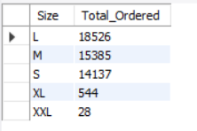
QUESTION 4
Identify the most common pizza size ordered
RESULT
QUERY

Slide 9
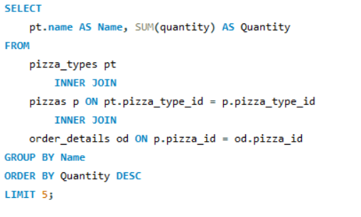
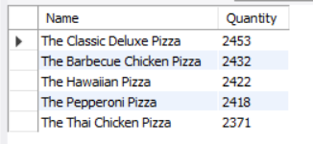
QUESTION 5
List the top 5 most ordered pizza types along with
their quantities.
RESULT
QUERY

Slide 10
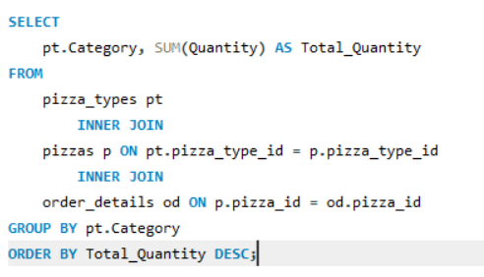
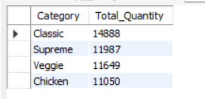
QUESTION 6
Join the necessary tables to find the total quantity of each pizza category ordered
RESULT
QUERY

Slide 11
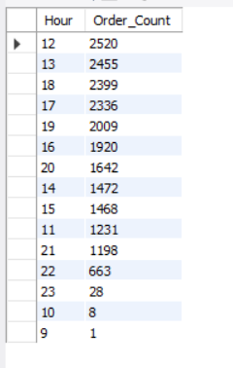
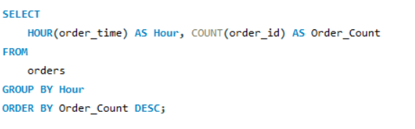
QUESTION 7
Determine the distribution of orders by hour of the day.
QUERY
RESULT

Slide 12
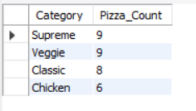
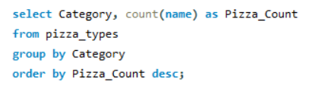
QUESTION 8
Join relevant tables to find the category-wise distribution of pizzas.
QUERY
RESULT

Slide 13
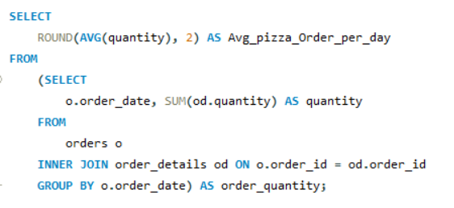

QUESTION 9
Group the orders by date and calculate the average number of pizzas ordered per day
RESULT
QUERY

Slide 14
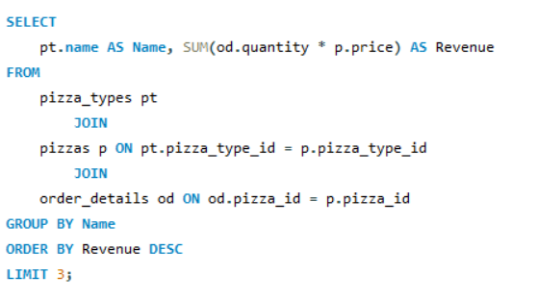
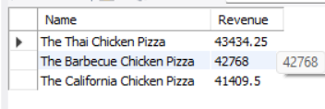
QUESTION 10
Determine the top 3 most ordered pizza types based on revenue
RESULT
QUERY

Slide 15
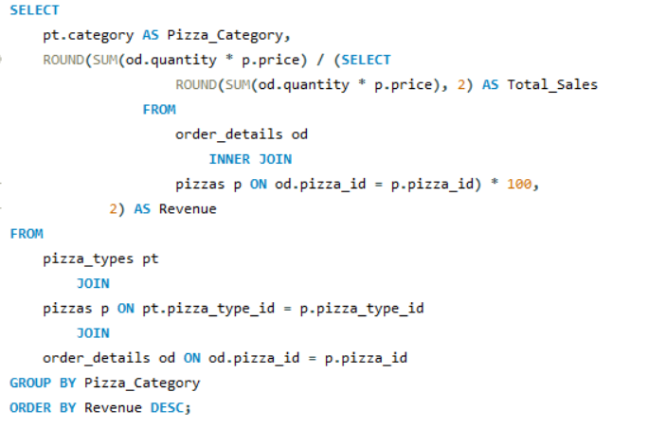
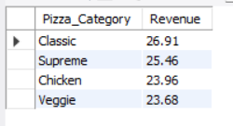
QUESTION 11
Calculate the percentage contribution of each pizza type to total revenue
RESULT
QUERY

Slide 16
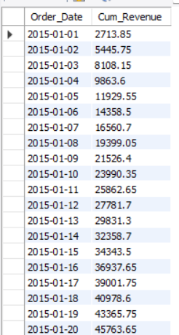
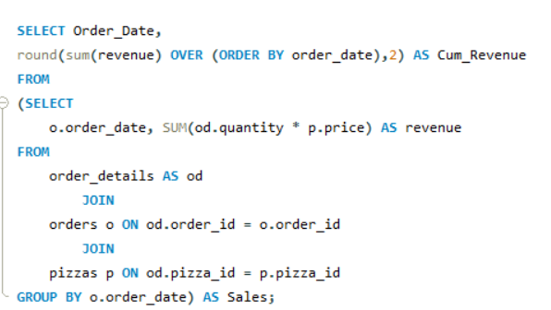
QUESTION 12
Analyze the cumulative revenue generated over time.
RESULT
QUERY

Slide 17
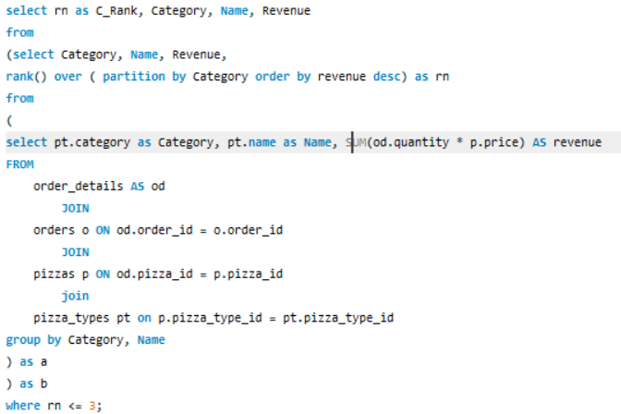
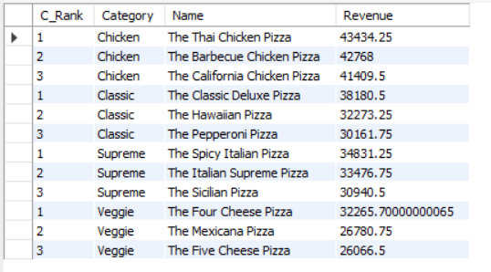
QUESTION 13
Determine the top 3 most ordered pizza types based on revenue for each pizza category
RESULT
QUERY

Slide 18
THE END

